Slide 1
Lending Club – Case Study
Lending Club – an online agency which hosts a marketplace to mediate between investors and borrowers wants to analyse their data to minimise the risk of losing money while lending to customers.
We were offered a small subset of data between 2007 and 2011 (5 years) to identify driving factors for a profitable business.
James Jeyabalan / Akik Ranade

Slide 2
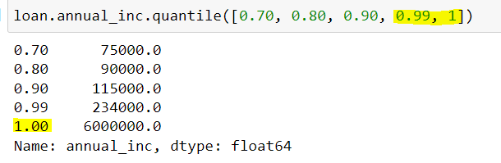
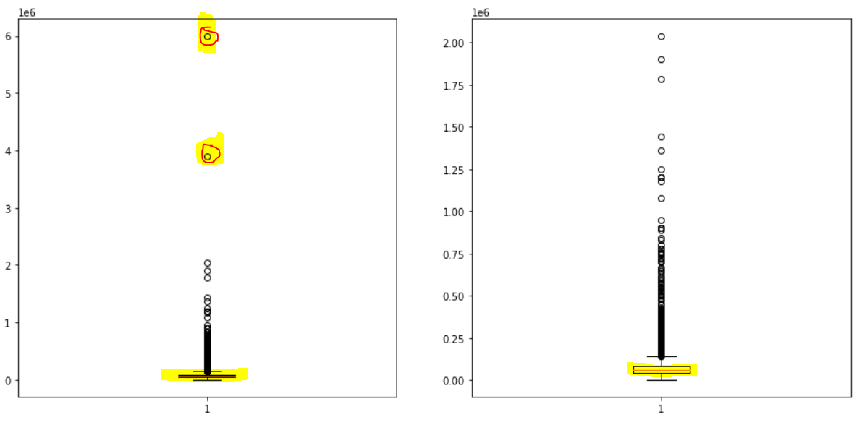
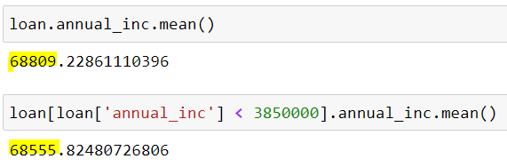
Observation - 1
There are couple of borrower's Annual Income values that are very high but it doesn't skew the mean or median. Hence those values were not considered as outliers

Slide 3
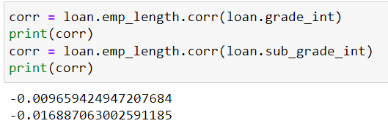
Observation – 2
There is no correlation between Borrower's Income & Grade/Sub Grade (Financial Rating)

Slide 4
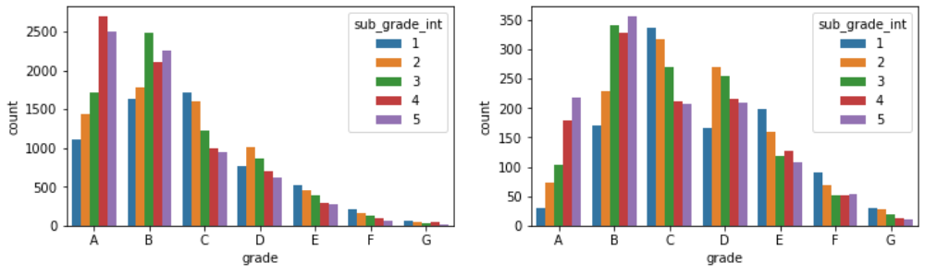
Observation – 3
“Fully Paid” Category has borrowers in grade A & B predominantly
“Charged Off” Category borrowers shift towards grade B & C

Slide 5
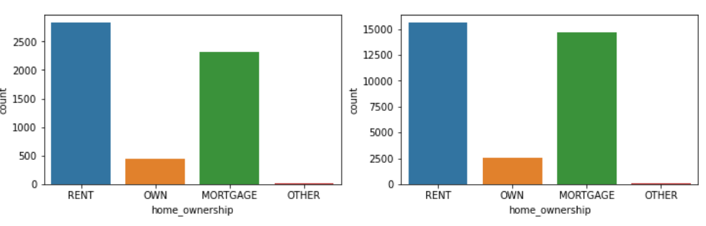
Observation – 4
Home Ownership Pattern doesn't signify the risk of loan default as there is hardly any difference

Slide 6
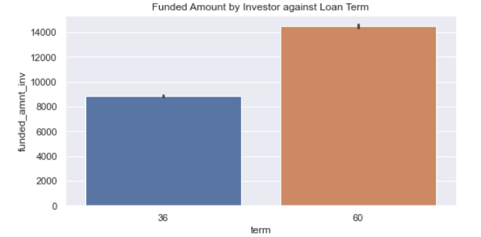
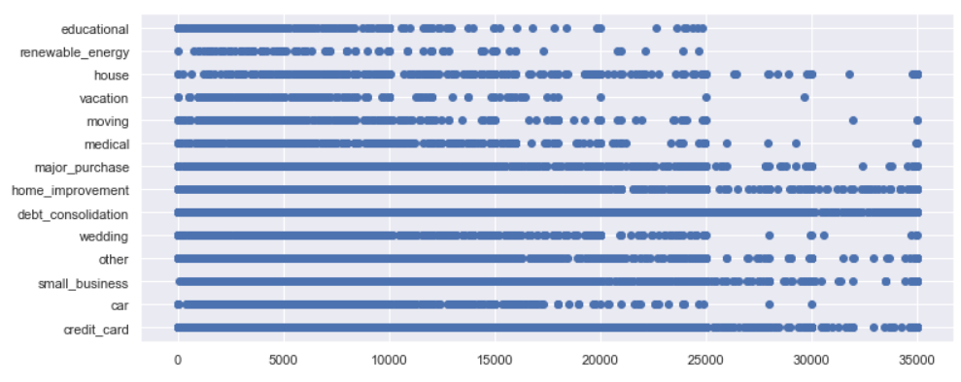
Observation – 5
Longer the term, higher the loan amount taken
Higher loan amounts are predominantly taken for Debt Consolidation, Home Improvement & Credit Card

Slide 7
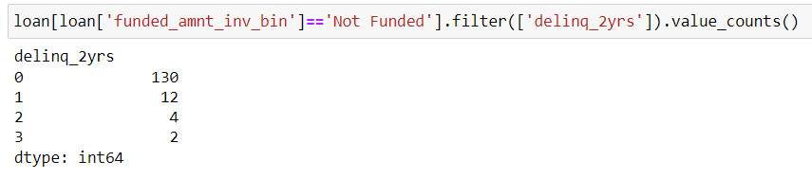
Observation – 6
Delinquent in the last 2 years shows 10% default rate in the Not Funded category

Slide 8
Appendix

Slide 9
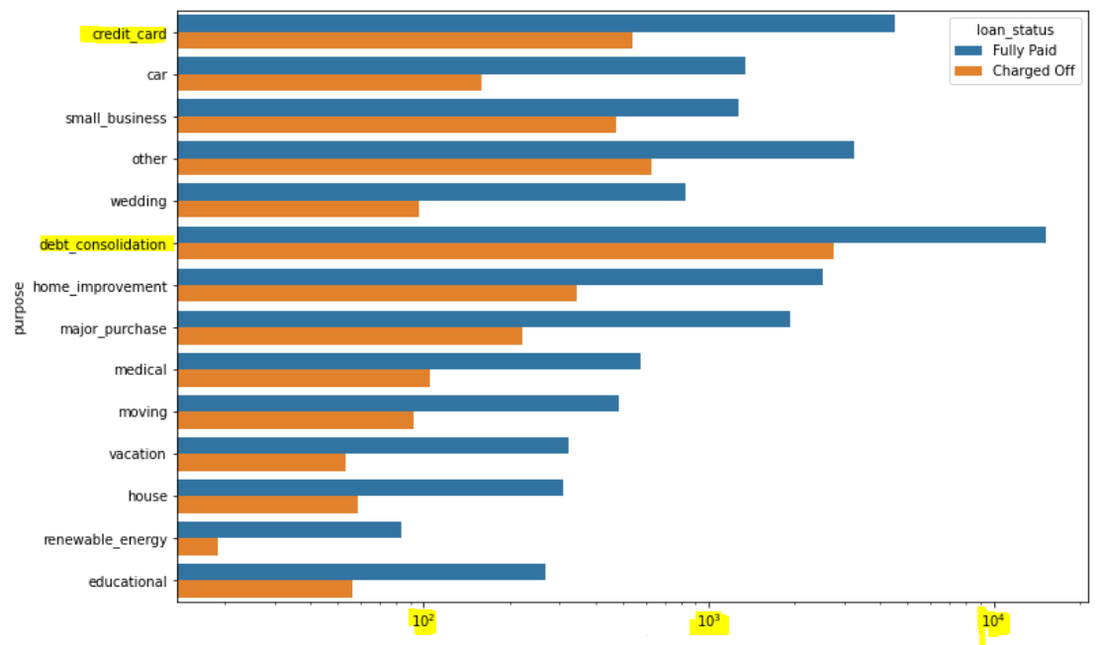
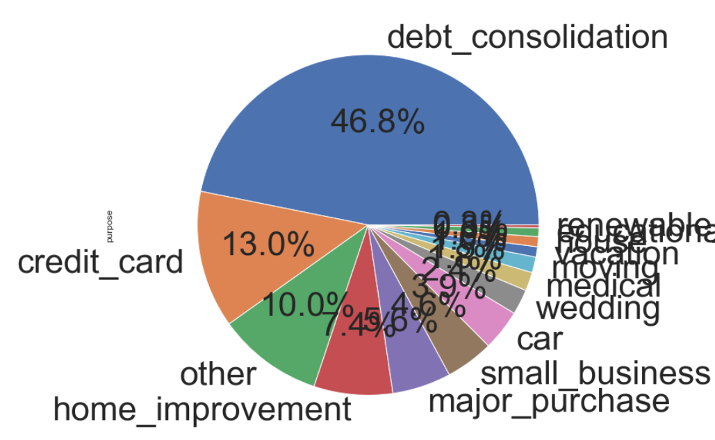
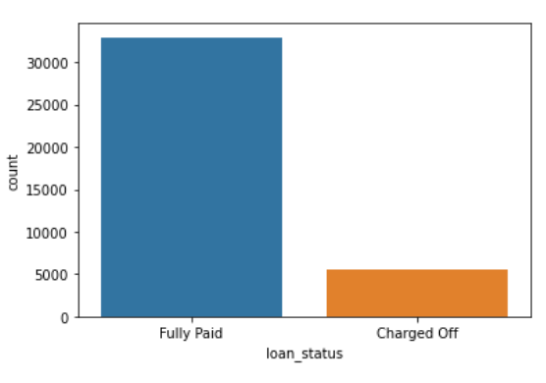
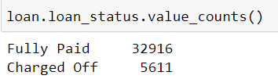
Analyse: Distribution Patterns
Distribution of loan by “Purpose”
“Debt Consolidation” is the single largest loan purpose across “Fully Paid” and “Charged-Off” borrowers
Distribution by “Loan Status”
(after removing ‘Current’ accounts)

Slide 10
Cleanse: Row-Column Elimination Reasoning
Raw data size (Rows: 39717, Columns: 111)
After removing “NA” columns (Columns: 57)
Effective memory utilization technique as the data set size reduced 50% (34 Mb to 17 Mb)
After removing descriptive columns (Columns: 50)
After removing UniValue (only 1 value or NaN) columns (Columns: 41)
After removing above80% missing columns (Columns: 38)
Eliminating Current accounts as they don’t authoritatively say whether the borrower is a defaulter or not.
# of Current accounts is 1140, of which only 121 rows show delinquency, and the last delinquency is an average 3 Years
Hence considering this subset of data has insignificant for any concrete decision and removing the “Current” loan accounts. Rows,
Rows after dropping this subset:(38577, 38)
Remove 50 rows with ‘NA’ value for revol_util column since we don’t want to impute this ‘Ratio’ field
Rows after dropping this subset:(38527, 38)

Slide 11
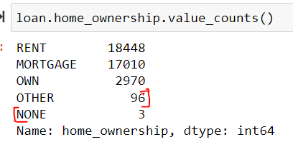
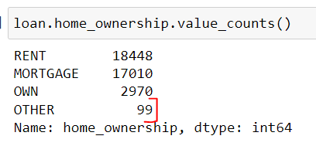
Cleanse Curing the data
Remove %, + symbols, String objects which could potentially be Numeric data after removing the unwanted text suffixing the number value
Add 2 derived attributes/categories like Year/Month
Add derived metrics like ‘Annual_Installment Amount’ to ‘Annual Income’ ratio (i2i) for analysis
Add fields to dataset by casting AlphaNumeric Codes in ‘grade’, ‘subgrade’ columns as “Int” for correlation analysis
Impute Employment Length of borrower with “mode” value for ~1000 rows which have NaN
Manual Reassign Home Ownership from one bin to another to reduce the # of categories

Slide 12
Thank you

